Slide 1
Crop Recommendation System
MINOR PROJECT-I (AD-508)

Slide 2


OUR TEAM MEMBER
Aman Sahu
Shyam Sahu
OUR GUIDE
Prof. Abhuday Tripathi

Slide 3
IDEA /APPROUCH / DETAIL
The concept of this project is to implement the crop selection method so that this method helps in solving many agriculture and farmers problems.
Crop recommendation methodology is used to predict the suitable crop by sensing various parameters of soil such as pH, Nitrogen, Phosphorus, Potassium and also parameter related to atmosphere such as rainfall, temperature.

Slide 4
ABSTRACTION
A crop recommendation system leverages data-driven techniques to assist farmers in selecting the most suitable crops for their land, aiming to optimize yield and promote sustainable agriculture. By analyzing factors such as soil quality, climate conditions, rainfall, the system provides tailored recommendations for different input features. Machine learning algorithms, such as Logistic Regression, are used to predict optimal crops based on input data. The system continuously improves by integrating real-time environmental data and user feedback, ultimately helping farmers make informed decisions, increase productivity, and minimize environmental impact.

Slide 5








TECHNOLOGY

Slide 6
REQUIREMENT
Functional
Non-Functional
User Registration and Authentication
User Profile updation
Input Collection
Crop Recommendation
Performance
Usability
Responsiveness
Scalability

Slide 7
REQUIREMENT
HARDWARE
SOFTWARE
Processor :-
Intel i3 and above
Operating system :-
Windows, Mac, Linux
RAM :-
4GB : Minimum
Coding Language :-
Python, Machine Learning
Hard Disk :-
256GB: Minimum
Tools & libraries :-
Vs Code, Numpy, Pandas, Scikit-learn, Matplotlib

Slide 8
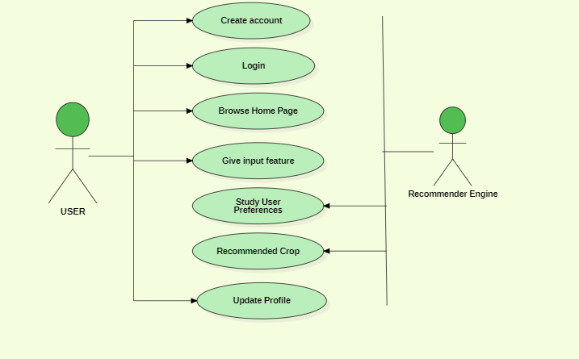
Use Case Diagram

Slide 9
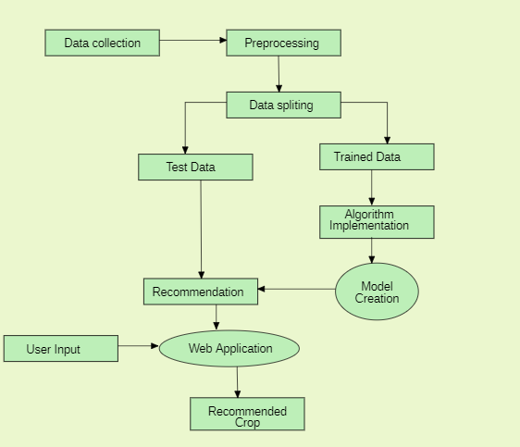
Data Flow Diagram

Slide 10
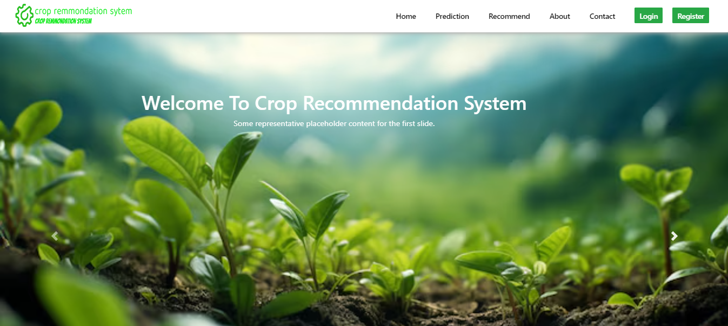
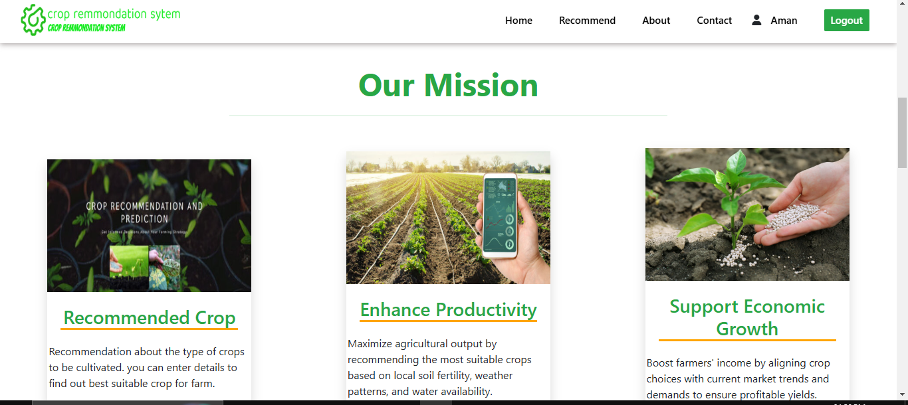
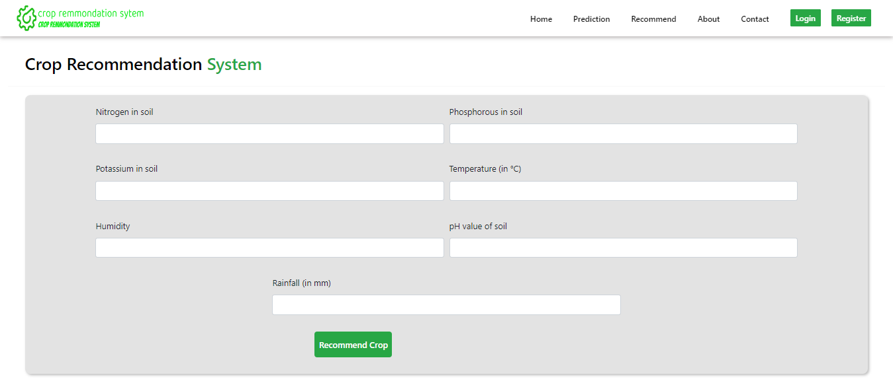
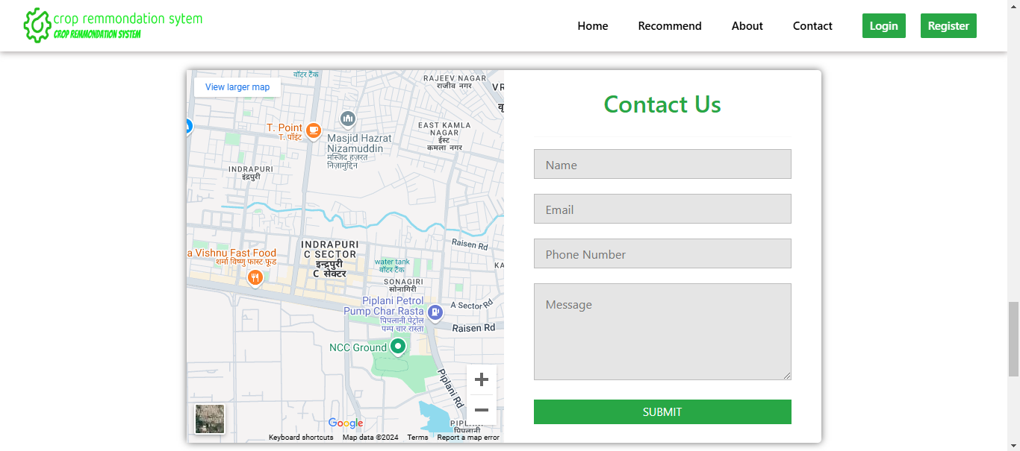
FRONTEND SCREENSHORTS

Slide 11
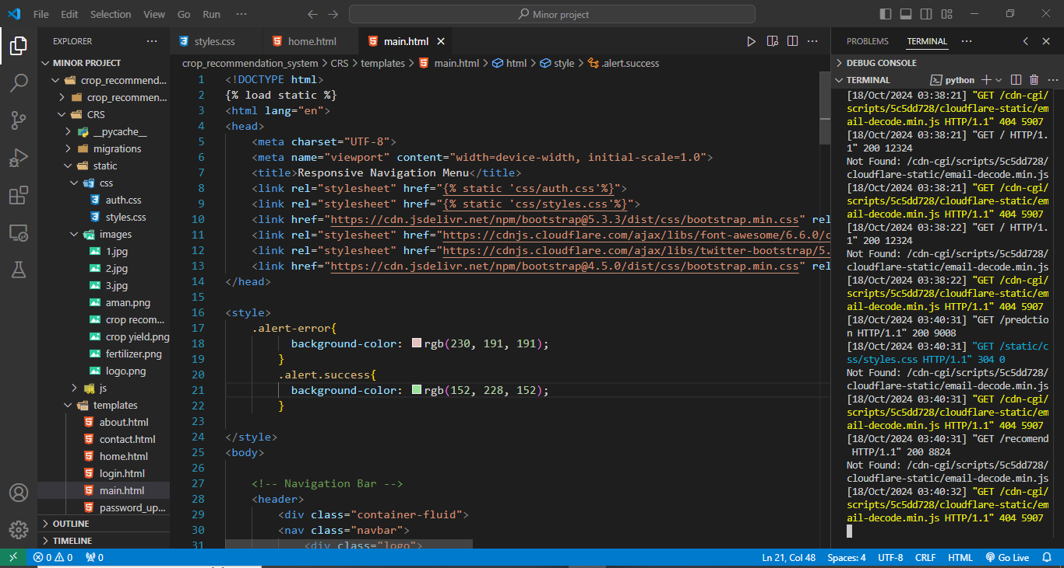
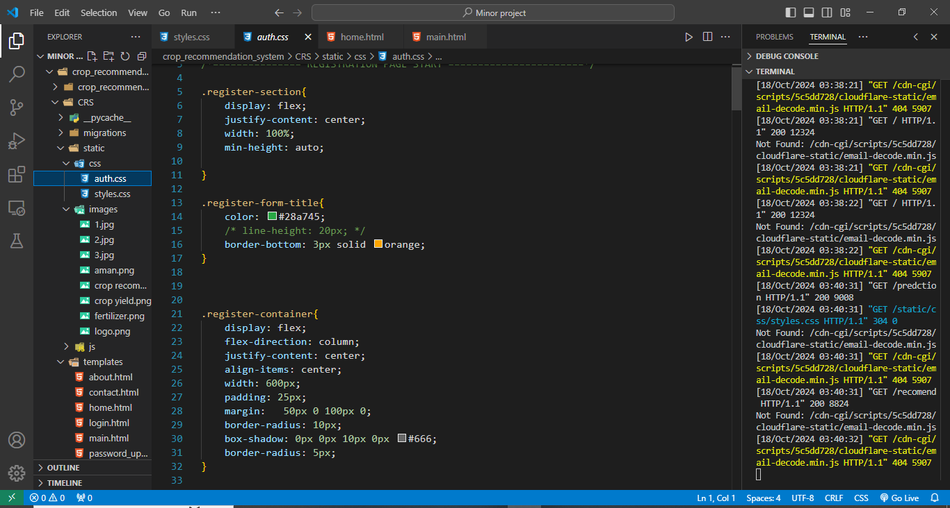
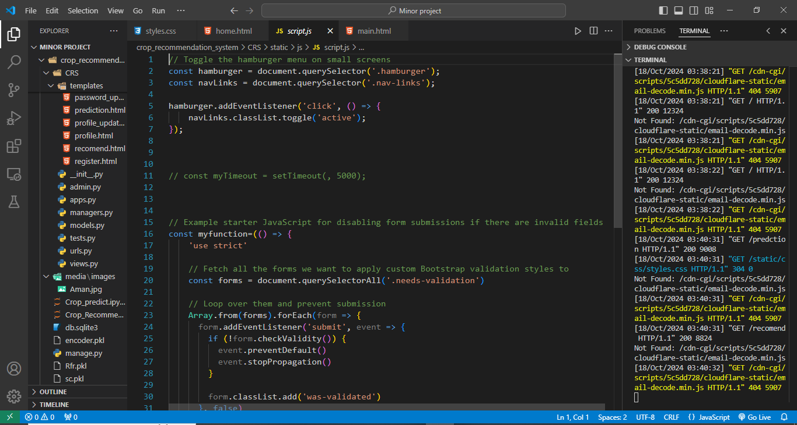
BACKEND SCREENSHORTS

Slide 12
THANK YOU

